Slide 1
Distributed Control and Automation Framework (DCAF)
Designing an Application with DCAF
Instructor Name
Instructor's role
Notes:
People that contributed with this content:
Benjamin Celis
Mathew Pollock
Simon Perez
Andres Gomez

Slide 2
Agenda
DCAF Application Elements
Using Existing DCAF Plugins
Deciding When to Build New Plugin Modules
How many Modules do I need?
Adding Functionality Outside DCAF
CVT
Shared Memory
Practical Exercise

Slide 3
DCAF Application Elements

Slide 4
DCAF Application Elements
Target*
DCAF Engine
Parallel Custom Code
Existing Modules
Custom Modules
Notes:
*We may have more than one engine per target

Slide 5
Using Existing DCAF Plugins

Slide 6
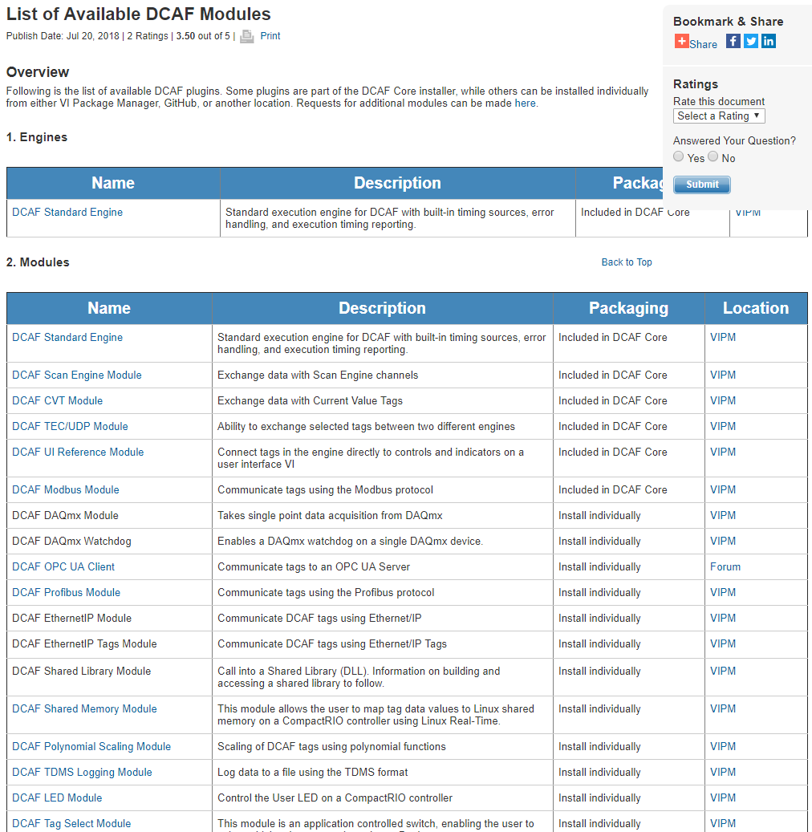
Using Existing DCAF Plugins
Consult the List of Available DCAF Modules Documentation.
Most of them are in VIPM.
Also check in GitHub.

Slide 7
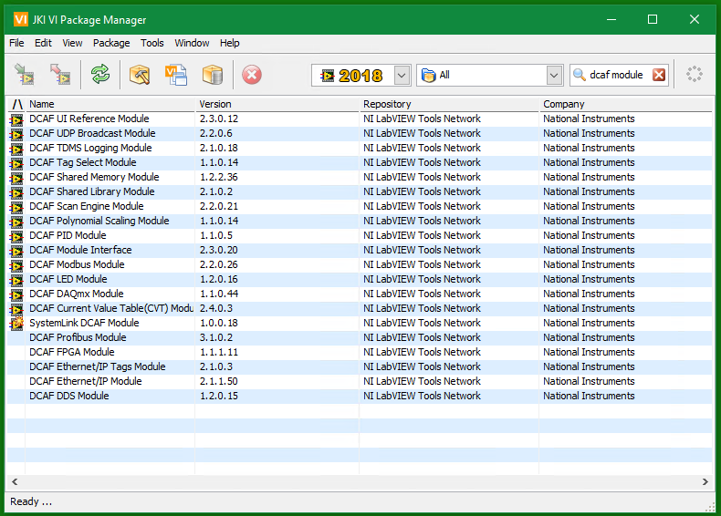
Available DCAF Modules

Slide 8
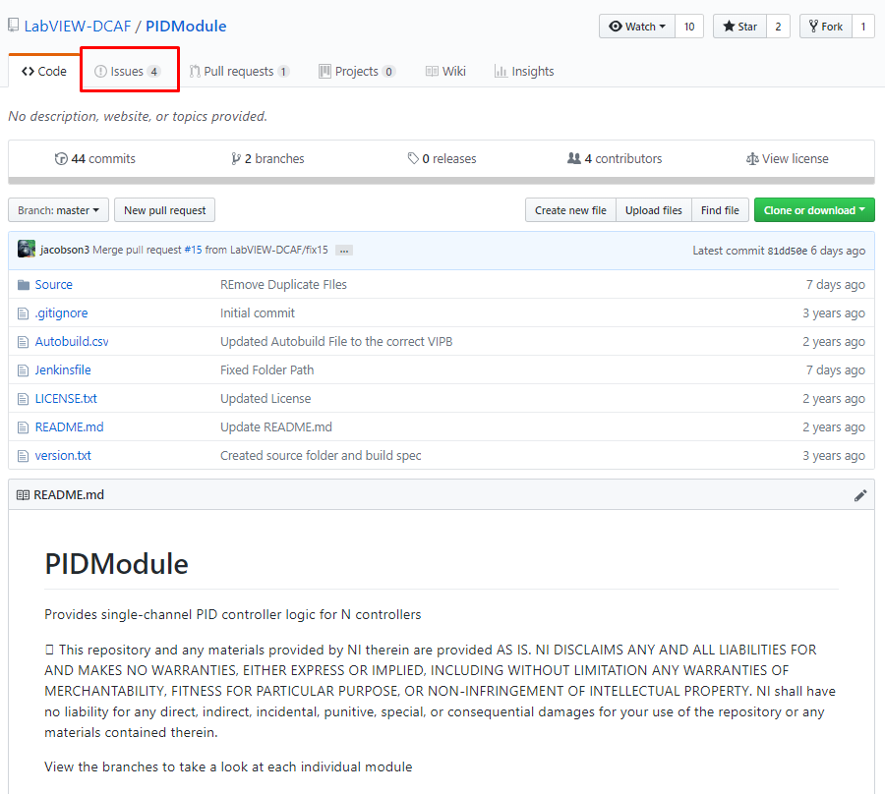
Using Existing DCAF Plugins
If you found the module you needed:
Test it in isolation to understand its features and detect potential gaps.
Document issues in the corresponding github page.
Collaborate by improving the module if desired!

Slide 9
Deciding When to Build New Plugin Modules

Slide 10
What Should be a Module
Modules should operate on latest value (Tag) data
They should generate new values, modify existing values, or route values
Communicating stream data between modules may not be a good fit

Slide 11
What Should be a Module
Application Specific vs Reusable
Application Logic could be within a module or outside of DCAF
Consider making a module into a state machine for control
Remember the state machine should not block
Do not hold state data in the module unless there can be only one instance

Slide 12
How many modules?
If two modules must always be used with each other, consider combining them.
Engine
Engine
Custom Input Module 1
Custom Process Module 1
Scan Engine Module
Custom Input And Process
Scan Engine Module
Outside
Outside
Outside
Outside

Slide 13
How many modules?
If multiple combinations are possible, keep them separate
Engine
Custom Input Module 1
Custom Process Module 1
Scan Engine Module
Shared Memory Module
Custom Process Module 1
Outside
Outside

Slide 14
Adding Functionality Outside DCAF

Slide 15
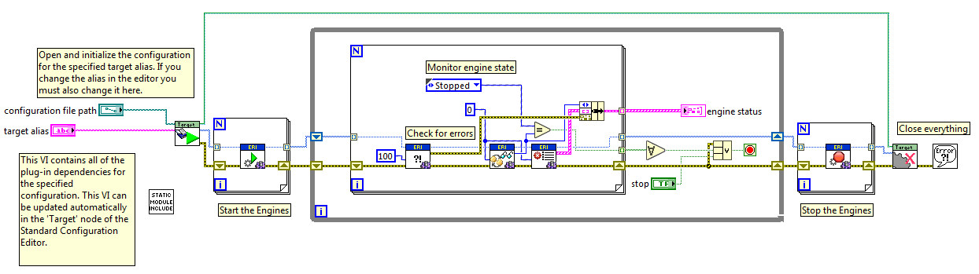
Running the Configuration

Slide 16
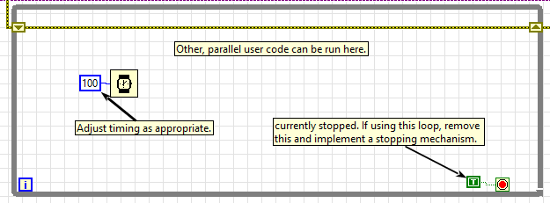
Coding outside DCAF
Example loop from the project template
Only need to call the engine and check, other code can run alongside as needed
Notes:
If functionality is not provided out of the box, and isn't a good fit for a new DCAF module, it can still be added to the application's Main VI. All DCAF applications must contain code to gather the configuration data and start up the engines to execute that data. The template also creates an empty loop where application specific code can be added.
If a DCAF engine can't do something well, the functionality can still be added to the main application using standard LabVIEW programming practices. For example, the loop above could contain code to read a high-resolution stream of buffered data from an FPGA and stream that data over the network (something DCAF is not designed to do well). Meanwhile DCAF can still be used to handle the more standard control functionality.

Slide 17
CVT

Slide 18
Coding outside DCAF - CVT
Main VI
Engine API
Other LabVIEW Code
Engine
Input
CVT
Output
CVT Variables

Slide 19
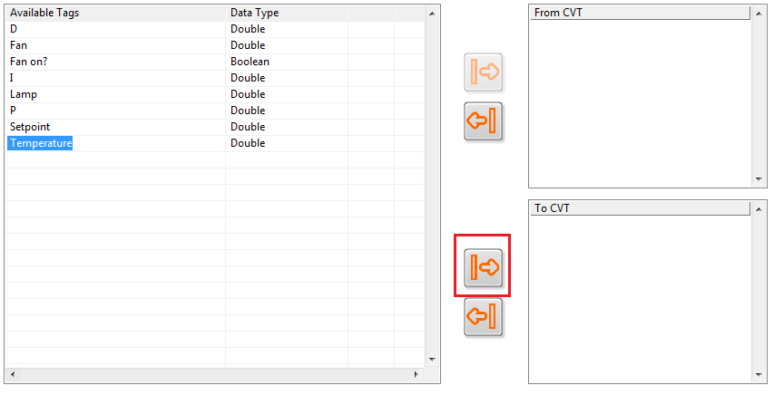
Coding outside DCAF - CVT
To get Tag Data out of DCAF into the same main application, use CVT
Pass the Tag to the CVT Module

Slide 20

Coding outside DCAF - CVT
Read the Tag with the CVT API
Use the Tag data in your application

Slide 21
Shared Memory

Slide 22
Shared Memory
RT
RT
NI-RIO
FPGA
DCAF can access Linux Shared Memory through a standard Module
Tags can then be accessed from LabVIEW or other languages
C/C++
Shared Memory
LabVIEW (DCAF)
Scan Engine
RIO Scan Interface
I/O

Slide 23
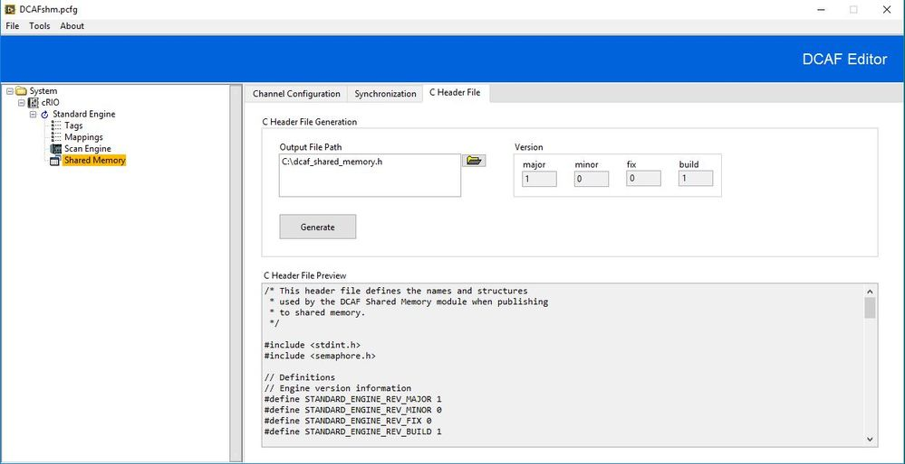
Shared Memory
Notes:
Application templates exist in addition to the plugin templates.

Slide 24
Practical Exercise

Slide 25
Practical Exercise
Requirements:
Using NI CompactRIO running LV Real-Time.
Monitoring 16 temperature channels at 10 Hz.
Bidirectional communication with third party chiller instrument through RS232.
Controlling 32 valves through 24V Digital Outputs using a PID.
Reading 4 RS485 Modbus Pressure Sensors at 25 Hz.
Logging temperature and pressure values continuously. Logged files should be automatically sent to a server once per day using WebDAV.
Sending tag values of temperature and pressure to HMI connected in the same network.
For a certain finite test, a waveform is streamed from the HMI at 10000 samples per second. Waveform is sent through an Analog output channel.

Slide 26
Practical Exercise
Questions:
What features can be implemented with existing DCAF modules?
What features could be implemented as new DCAF modules?
What features could be implemented as a parallel process to DCAF?

Slide 27
Practical Exercise
Potential Answers:
What features can be implemented with existing DCAF modules?
Scan Engine: Monitor temperature and control valves.
PID Control.
Modbus: Communicate with pressure sensors.
TDMS Logging: Log pressure and temperature.
UDP Module: Send tags to HMI.
What features could be implemented as new DCAF modules?
Communication with chiller.
WebDAV File Server.
What features could be implemented as a parallel process to DCAF?
Waveform streaming

Slide 28
Resources

Slide 29
Resources
DCAF Developer Guide:
Chapter 2: Application Design
Notes:
https://github.com/LabVIEW-DCAF/Documentation/blob/master/Trunk/Getting%20Started%20Material/devguide/ch2_Application%20Design.md

